Slide 1

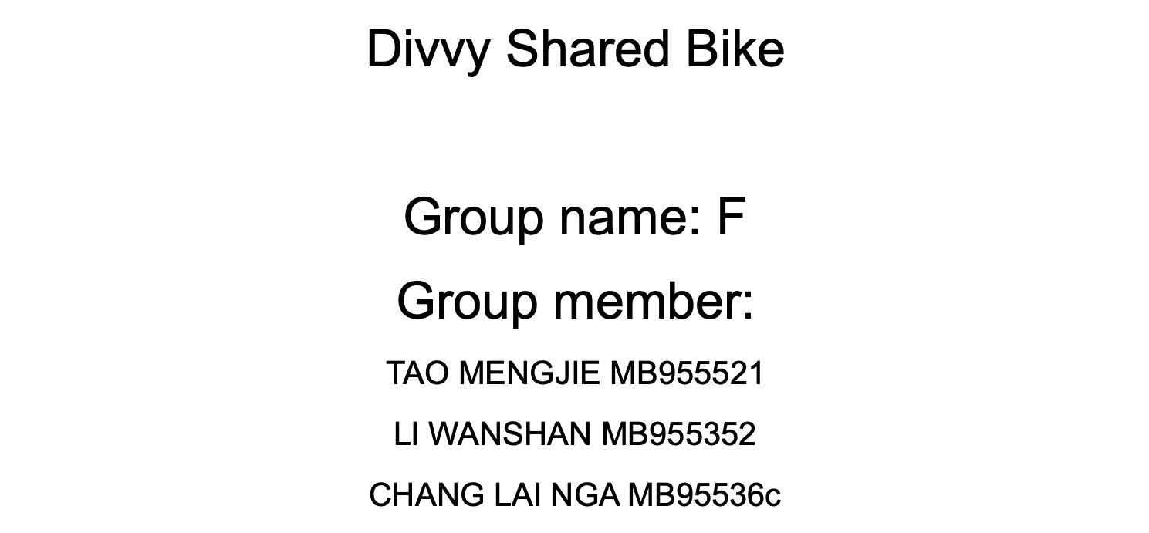

Slide 2




Slide 3

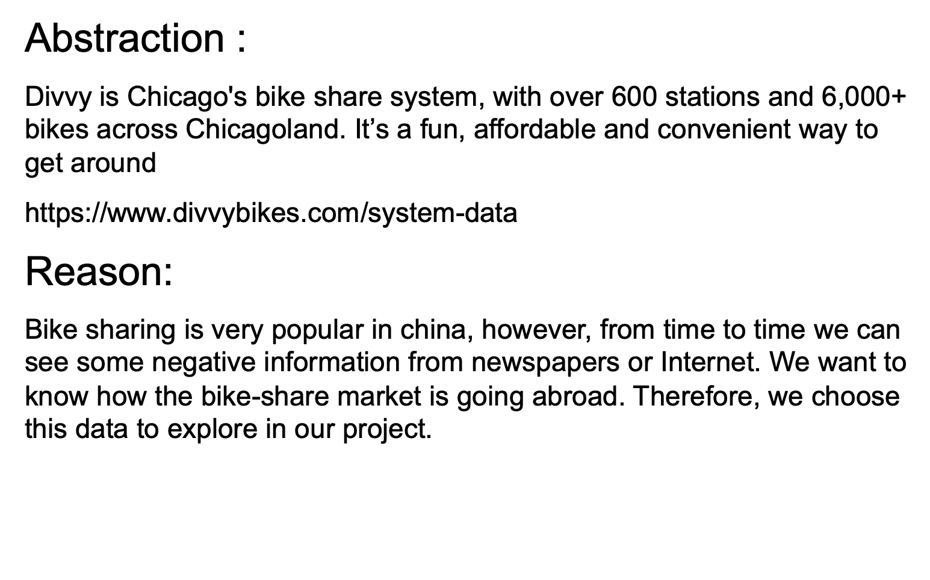

Slide 4


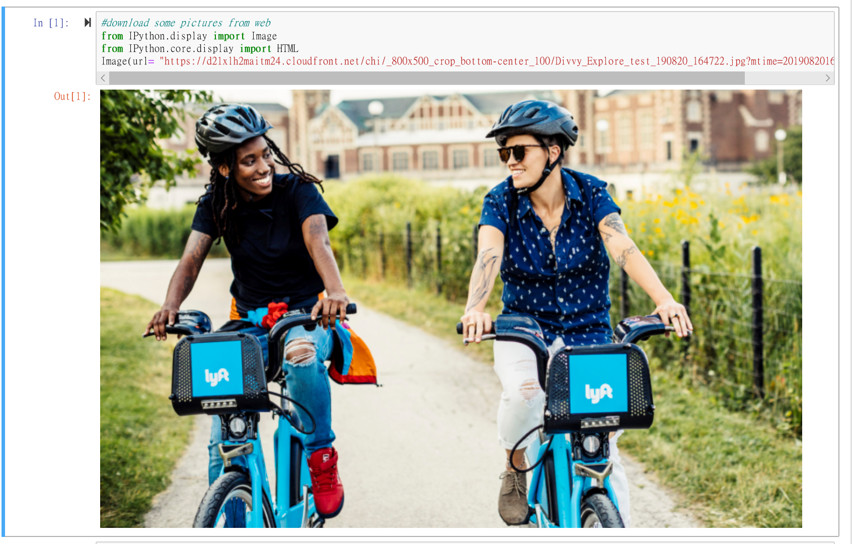

Slide 5
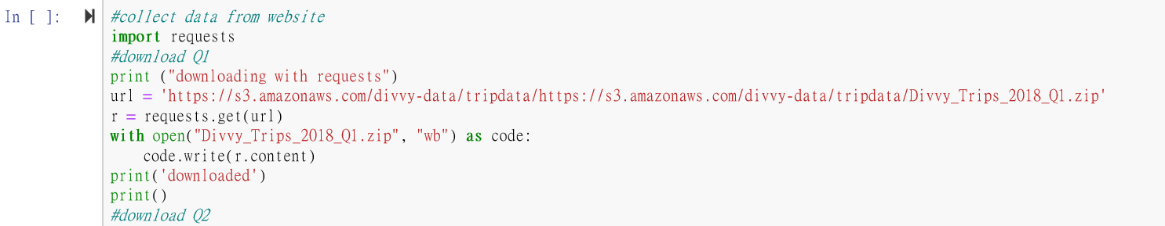
Second: Write the code to collect the data automatically, there are four csv files which represent different quarter respectively, and each csv file is 100M+( 473MB in total)

Slide 6

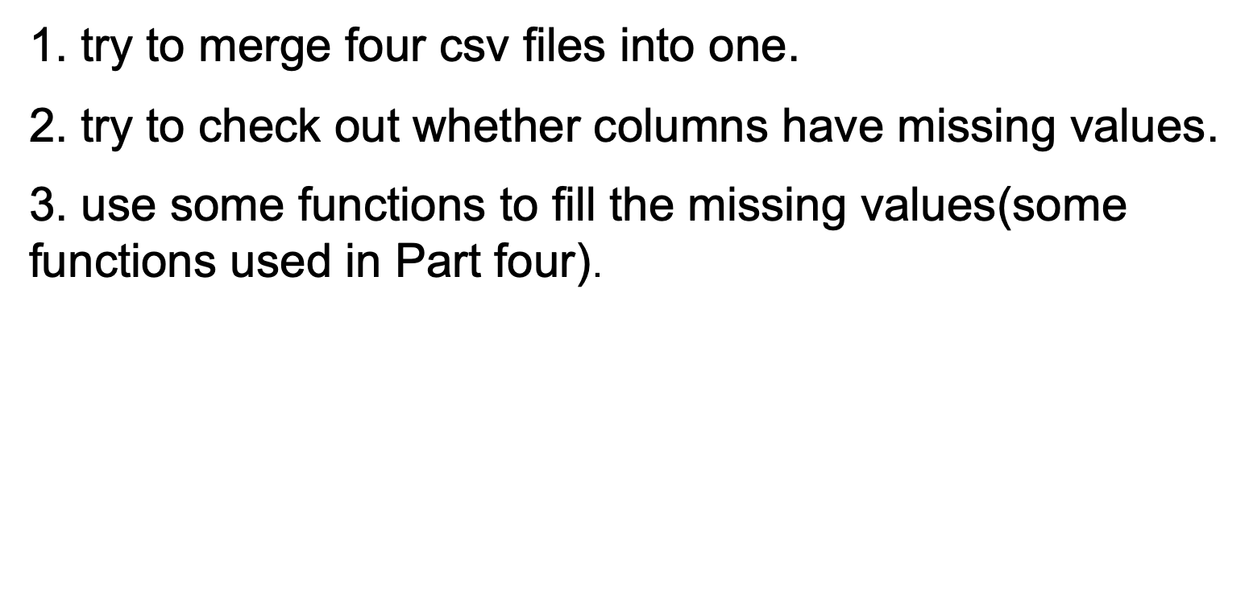

Slide 7

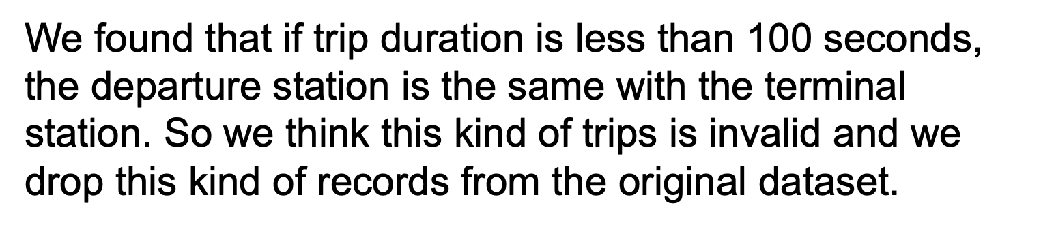
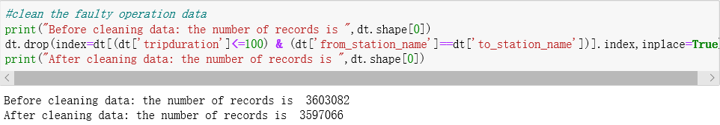

Slide 8
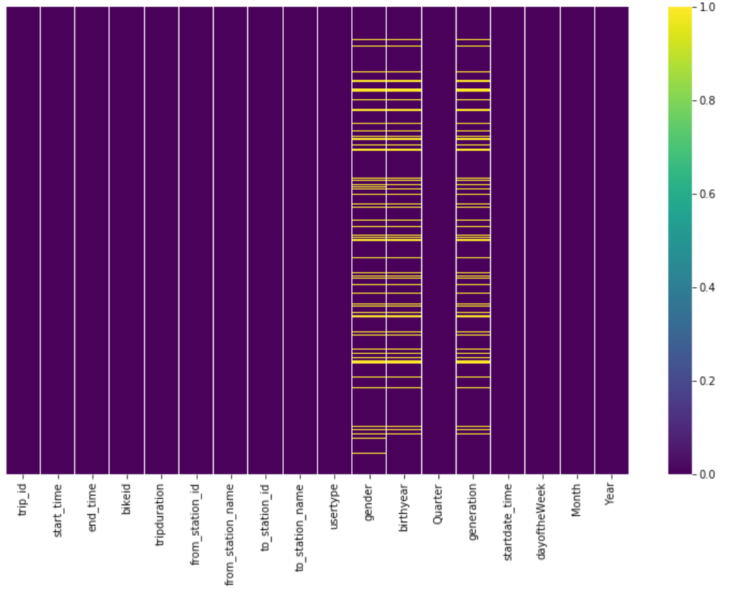
Visualize the missing values
Yellow line stands for missing value

Slide 9
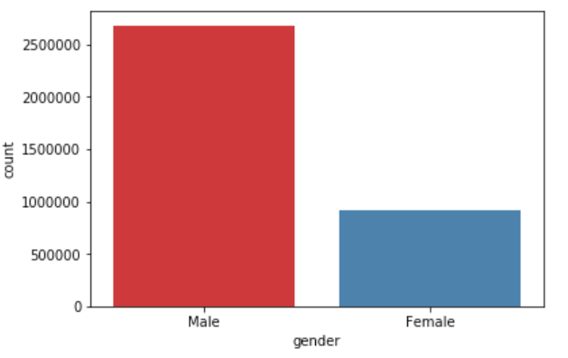
Try to propagate non-null values (male & female) forward in the 'gender' column, which can fill the missing values.
After we fill the missing values, we get the above chart.

Slide 10
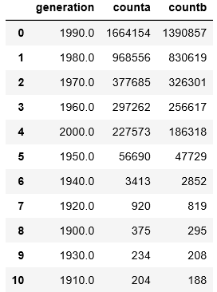
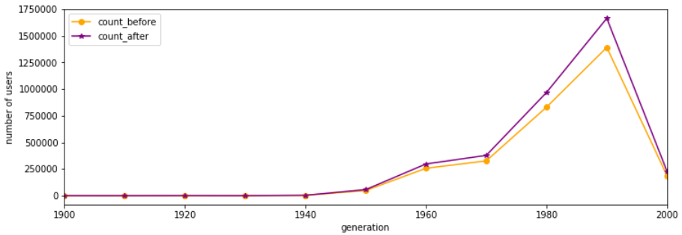
We fill in the missing values in ‘birthyear’ and ‘generation

Slide 11

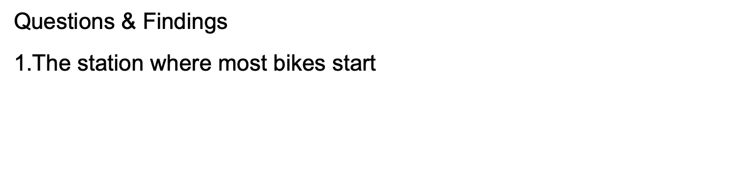
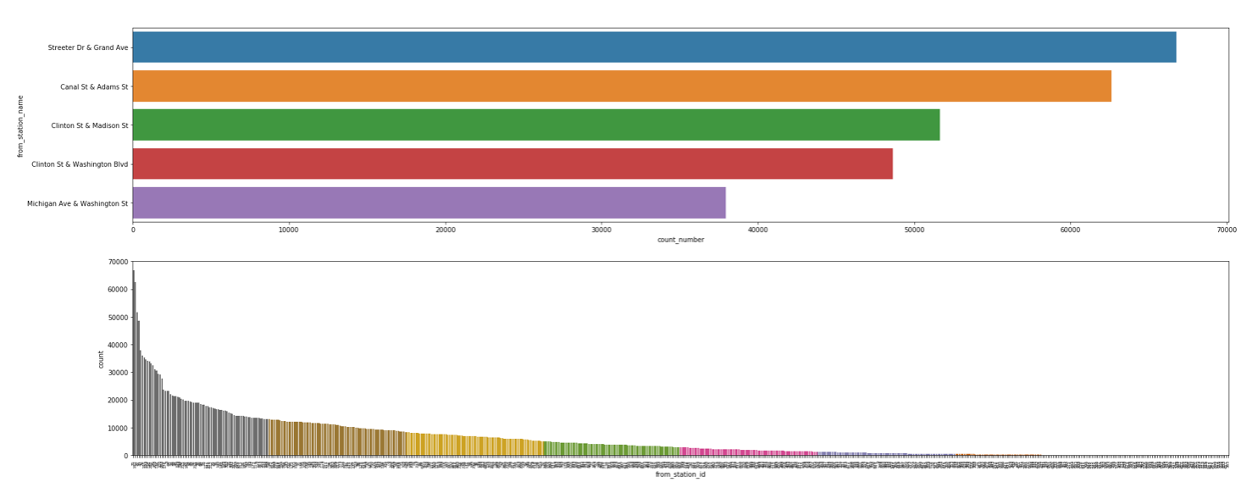
The first chart above shows most popular departure stations.
The second chart shows the usage of different departure stations in descending order.

Slide 12
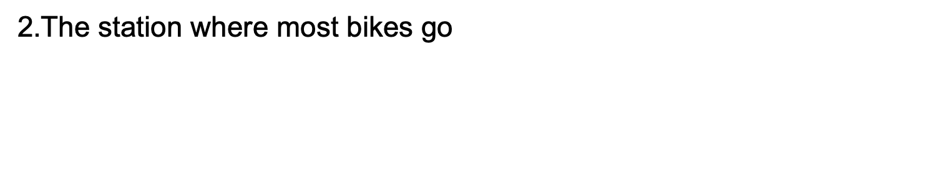
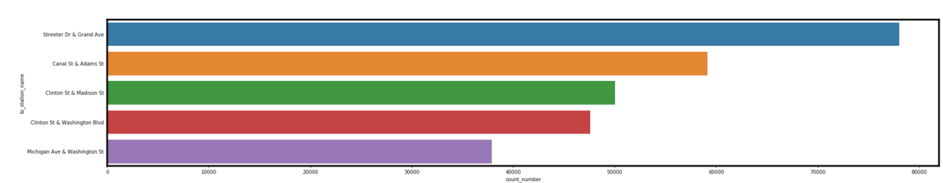
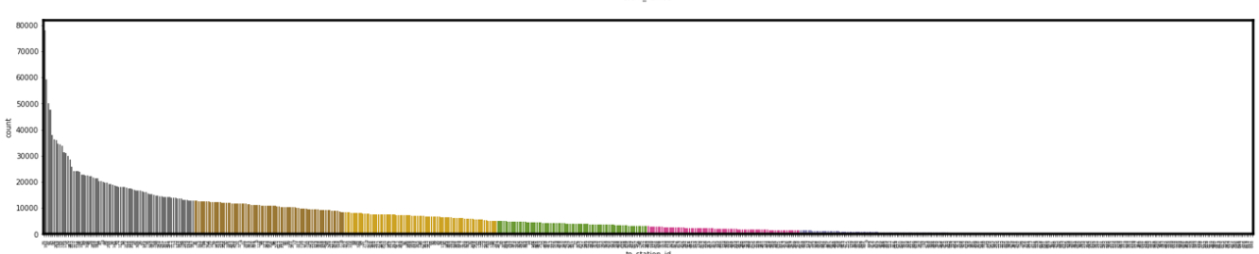
The first chart above shows most popular terminal stations.
The second chart shows the usage of different departure stations in descending order.

Slide 13

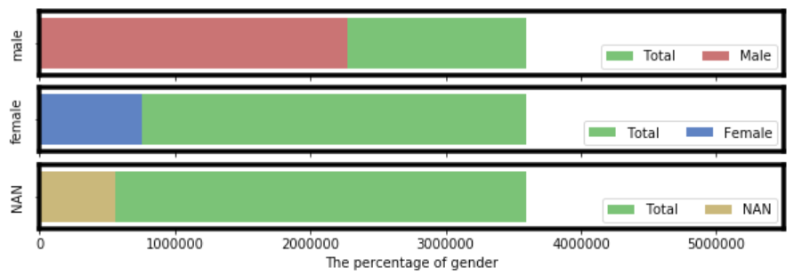
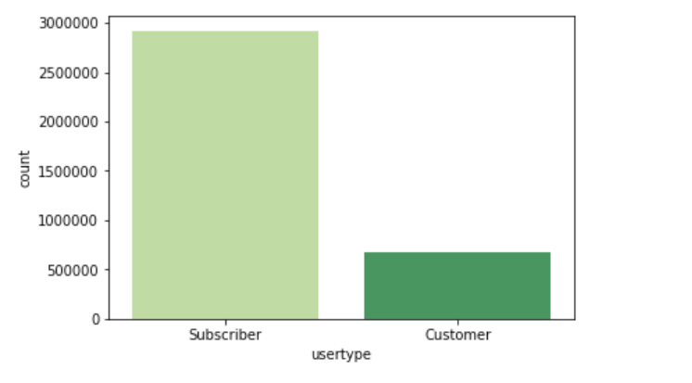
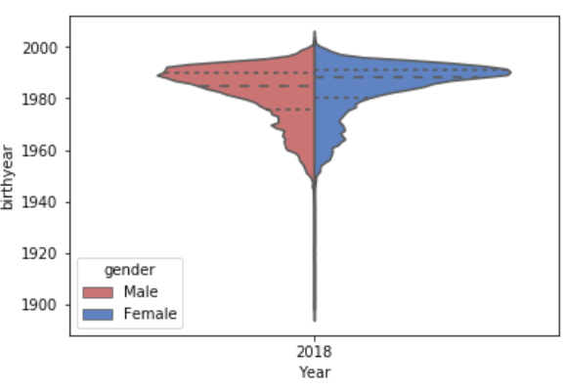
The majority of the users are male
The most popular user type is Subscriber
The post-1990 generation is a mainly group
use shared bike

Slide 14

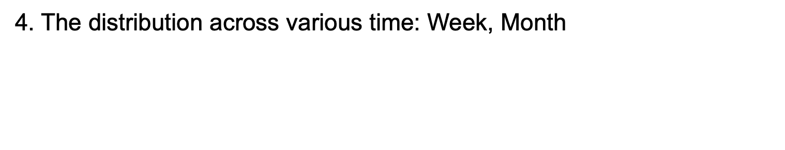
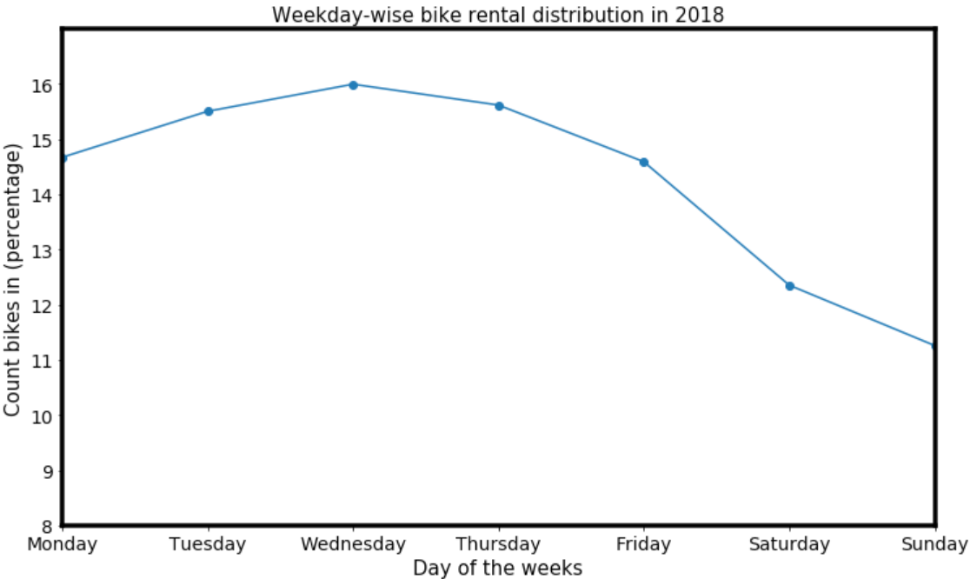
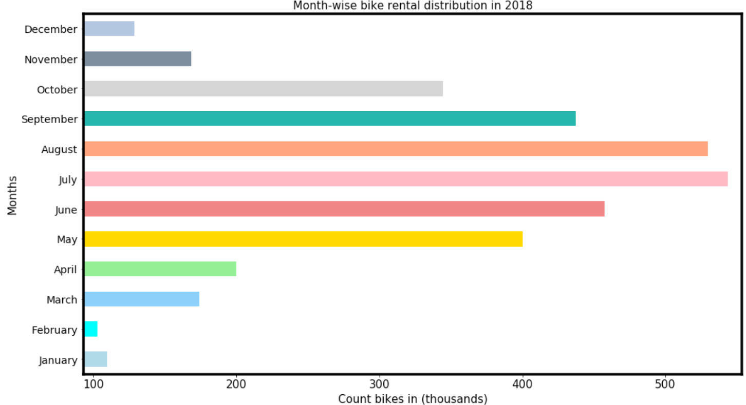
The above line plot is showing the bike distribution across the week days. Wednesday being on the highest bar we can say that Wednesday is the peak day people renting Divvy Bike. The plot clearly indicates that on Saturday and Sunday less number of users are owing the bike in comparison to the week days
The above bar plot is showing the breakdown in months, which is giving a clear indication of the winters in Chicago. July and August being on the highest bar and december, jan and Feb being on the lowest bar

Slide 15

1.The most popular stations may be located in downtown.
2. Shared bike is more popular among the males who is about 20 to 30 years old.
3. On Saturday and Sunday less number of users are owing the bike in comparison to the week days. And more users in summer rather in winter.

Slide 16

1.Seaborn
It provides a highly interactive interface that allows users to make a variety of attractive statistical charts.
Seaborn is actually a more advanced API package based on matplotlib, which makes drawing easier.
2.Collections(counter)
The counter function is to traverse all the elements in data structure and record the number of times the elements appear.
we use the counter function to analyze the types of elements in some columns.
3.Requests
Requests is a very useful Python HTTP client library, often used when writing crawlers and testing server response data.
we use Requests to collect data from the website in this project.

Slide 17


